Slide 1
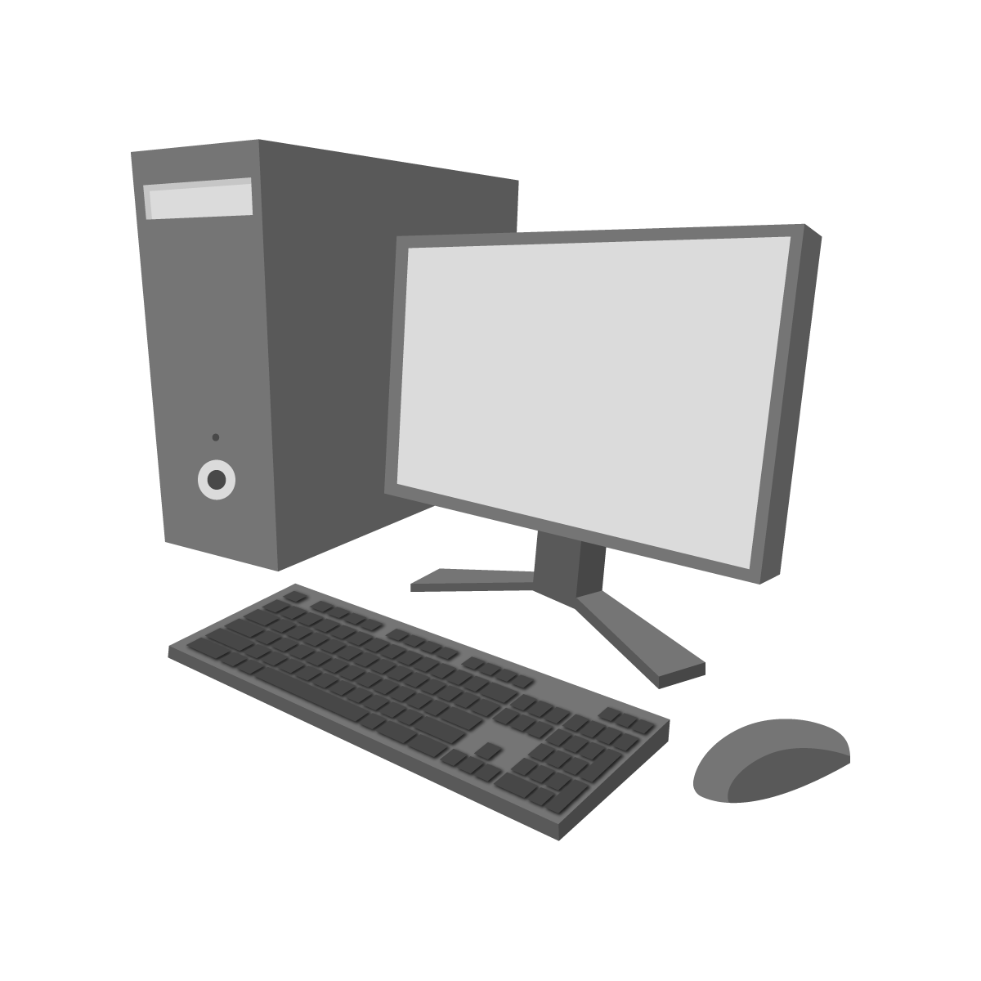
Anatomy of PC: A Deep Dive into Understanding and Assembling Your Own Computer
Section-1: Discussion on the Basic Components of Personal Computer (PC)
Section-2: Desktop PC Assembling (Step by Step Practically)

Slide 2
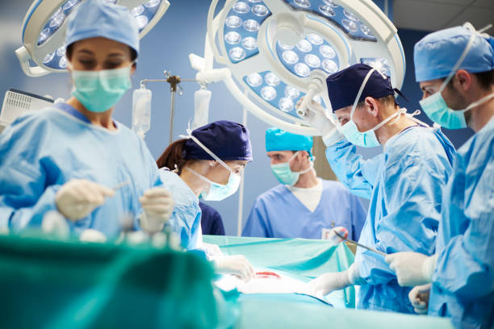
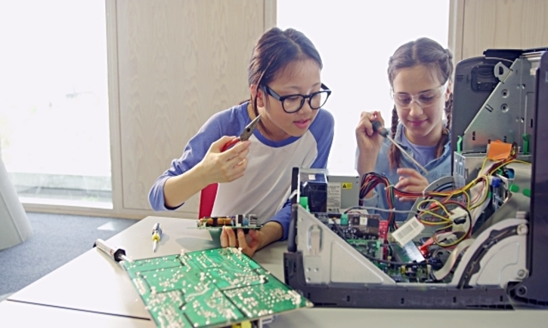
Operation Theatre!
For Human
For Computer

Slide 3
What is a Computer?
?

Slide 4
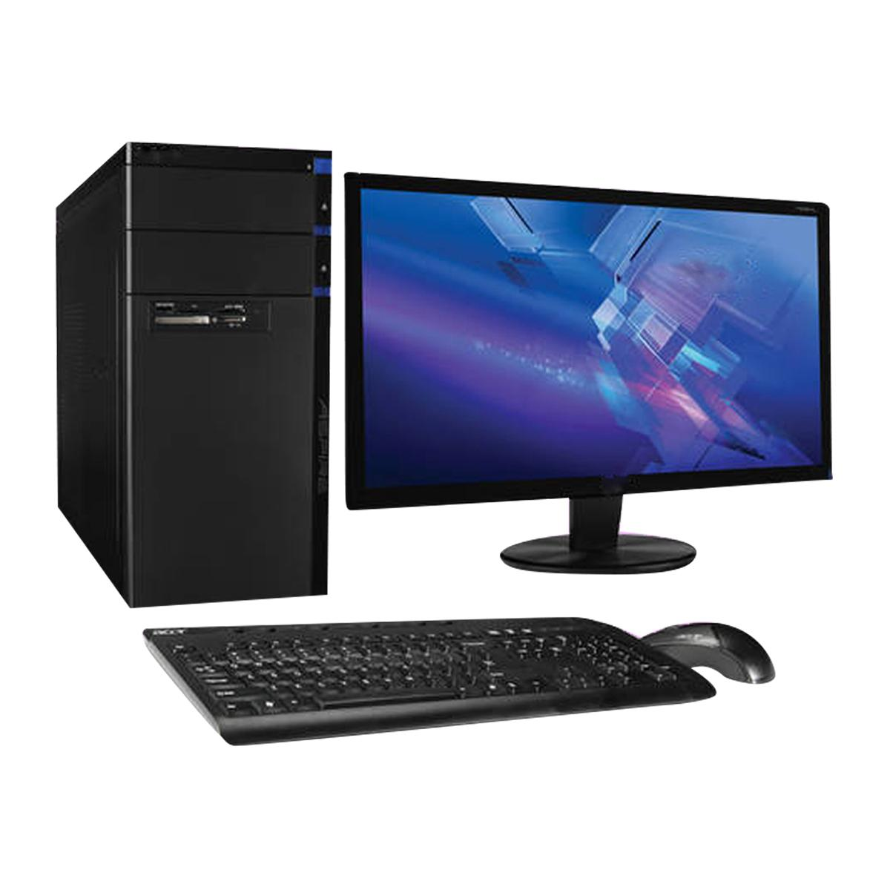
What is a Computer?
Electronic Device
Data Processing
Programmable
Input and Output
General Purpose
Notes:
Electronic device: A computer is an electronic device that uses digital signals to process and store data.
Data processing: A computer is capable of processing data, which means it can perform calculations, manipulate text and images, and perform other operations on the information it receives.
Programmable: A computer is programmable, which means that it can be instructed to perform specific tasks by running software programs that contain instructions for the computer to follow.
Input and output: A computer has input and output devices that allow it to receive data (such as from a keyboard, mouse, or touchscreen) and display or transmit data (such as on a monitor or printer).
General purpose: A computer is a general-purpose device that can be used for a wide range of tasks, rather than being designed for a specific purpose.

Slide 5
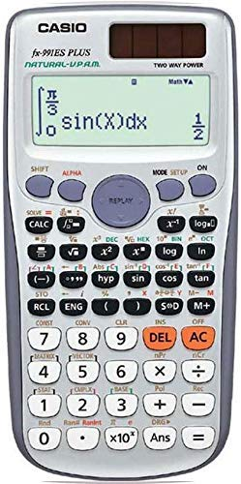
Is Calculator a Computer?
Notes:
No. limited type of computing device
Because: - limi

Slide 6
Calculator is a limited type of computing Device. Because:
1. Limited Functionality
2. Programmability
3. Operating System
4. Storage and Memory
5. Connectivity
Notes:
No. limited type of computing device
Because: - limi

Slide 7
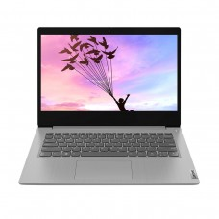
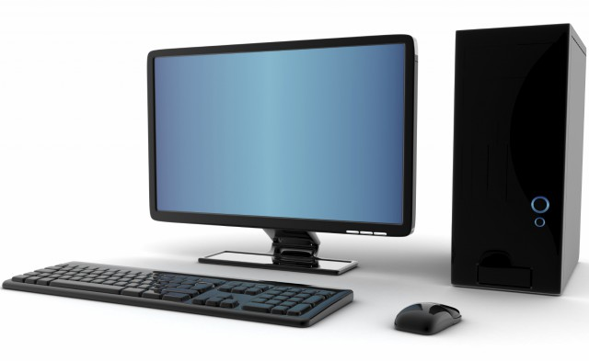
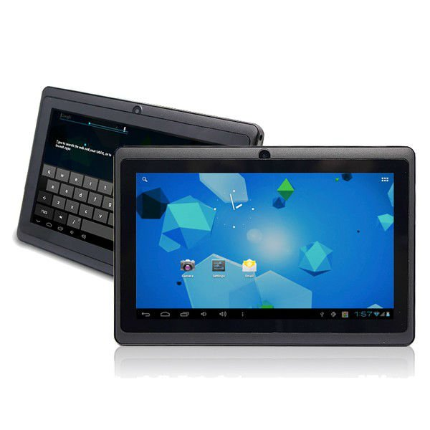
A Myth: PC vs Laptop vs Computer vs Desktop

Slide 8
Types of Personal Computers (PCs)
Laptop PC
Desktop PC
Tablet PC

Slide 9
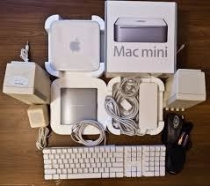
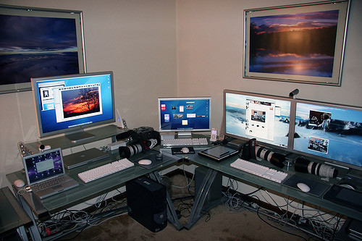
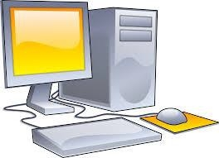
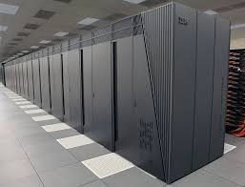

Types of Computers
Personal Computer
Workstation Computer
Mini Computer
Mainframe Computer
Supercomputer

Slide 10
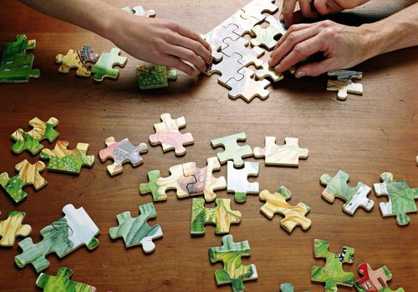

What is Assembling?
PC assembling is like solving a puzzle!

Slide 11
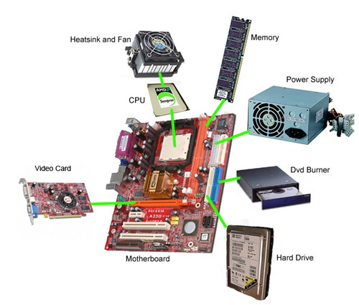
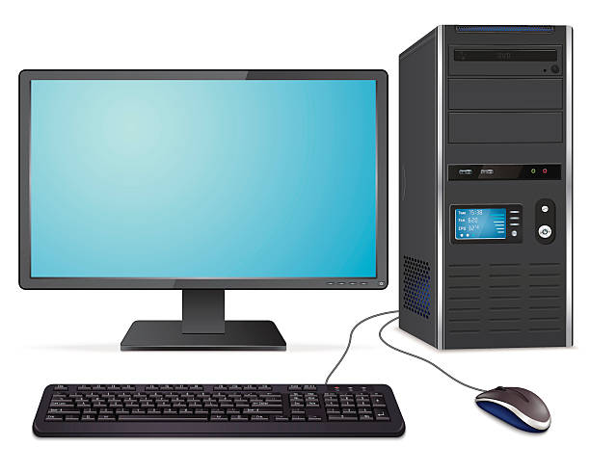
PC (Desktop) Assembling

Slide 12
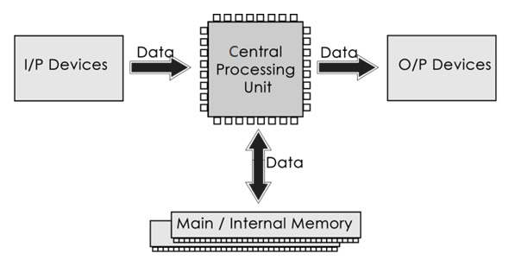
Basic Components of Computer

Slide 13
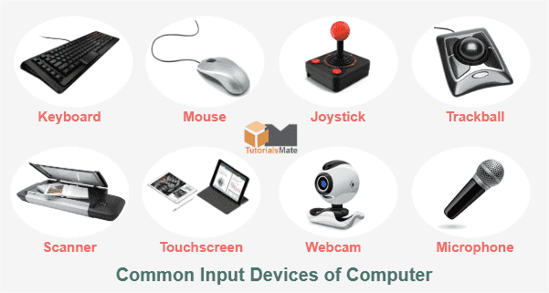
Input Devices

Slide 14
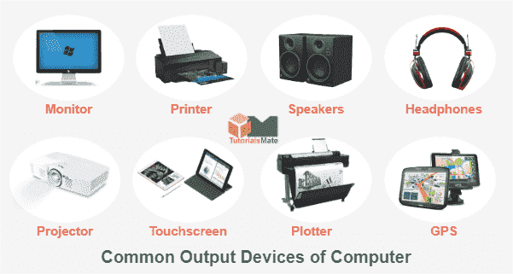
Output Devices

Slide 15
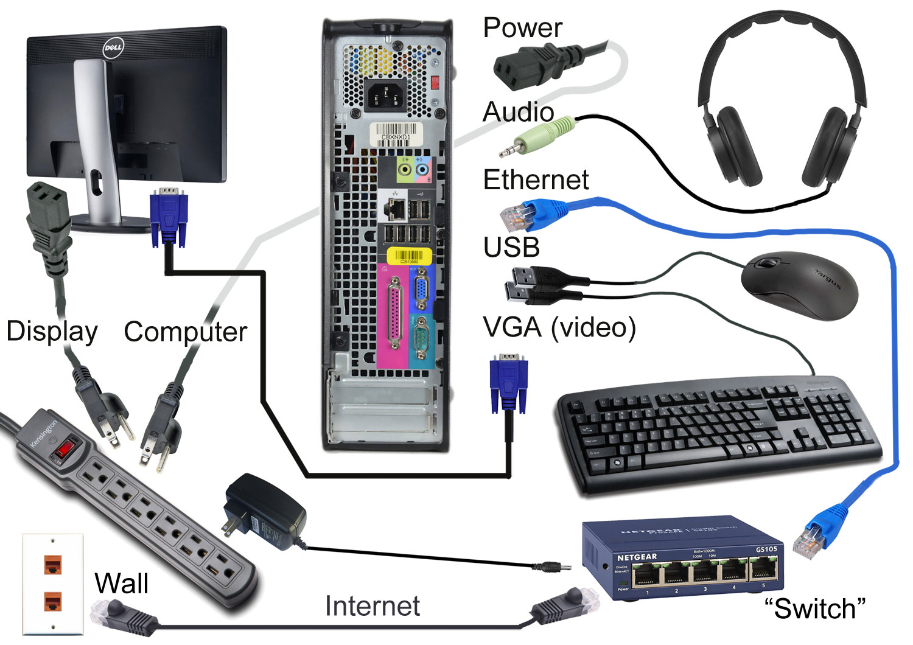
Connection of Desktop Computer

Slide 16
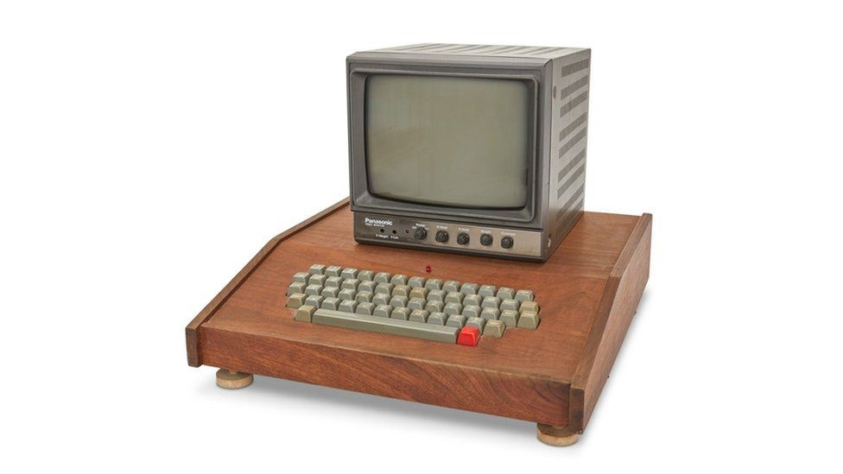
Discussion on the Important Components of Personal Computer

Slide 17
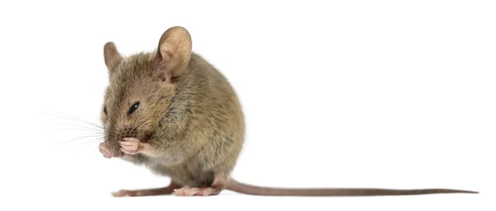

Slide 18
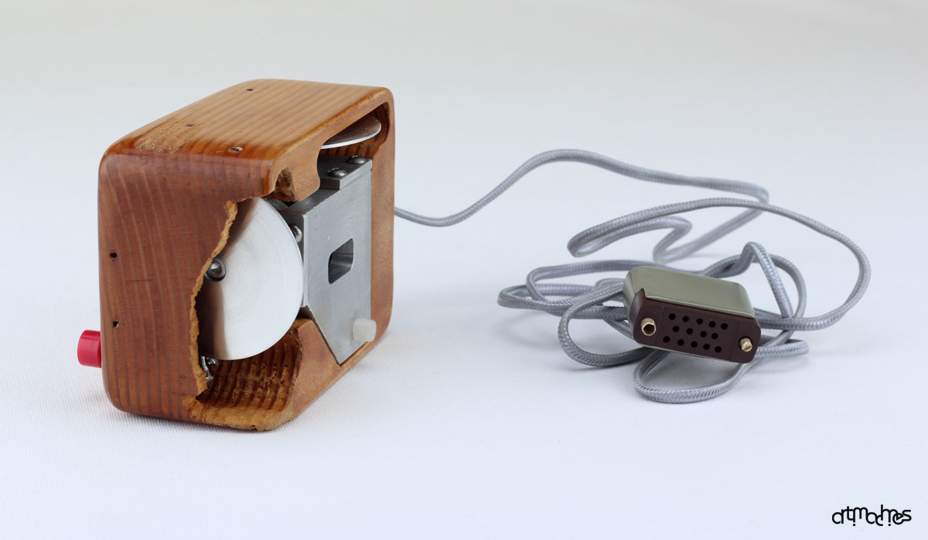
Mouse

Slide 19
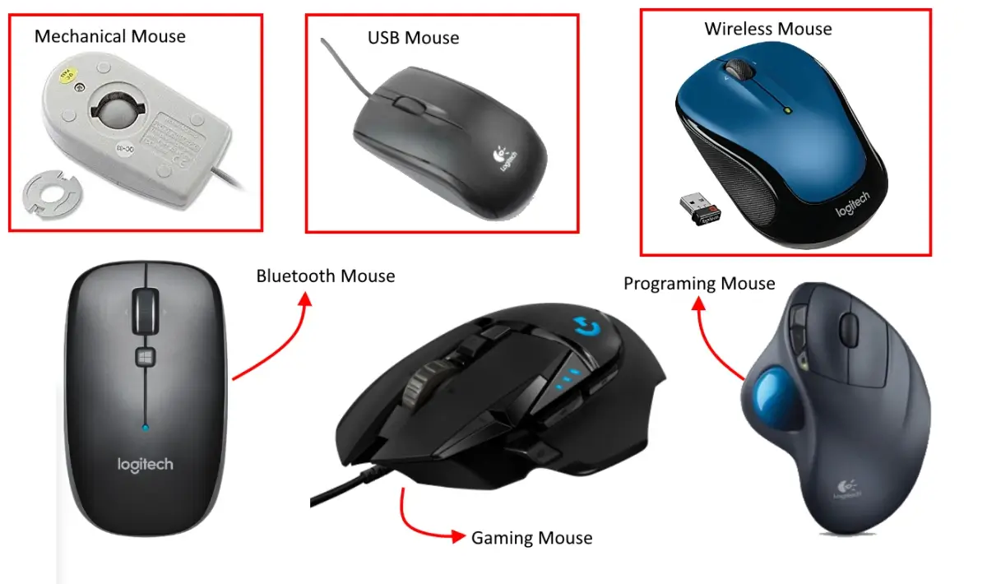
Types of Mouse

Slide 20
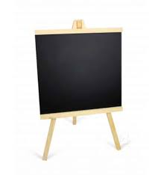
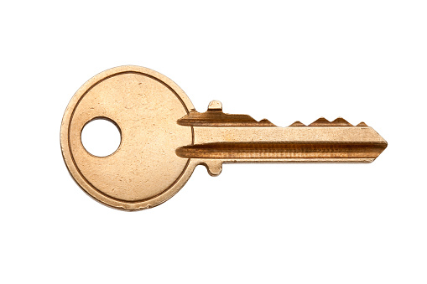

Slide 21
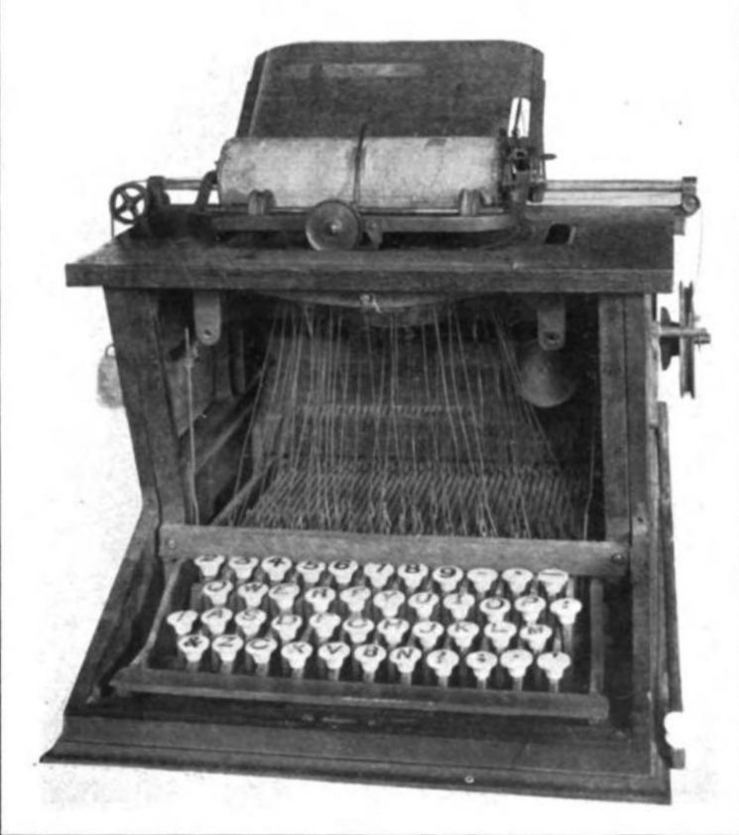
Keyboard

Slide 22
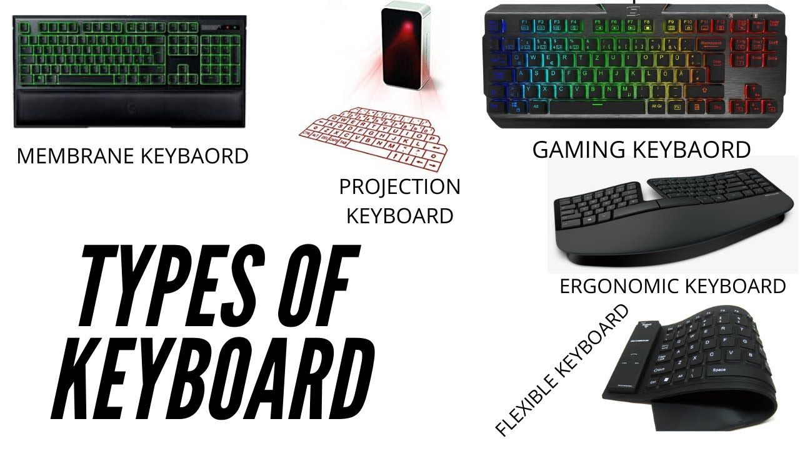

Slide 23
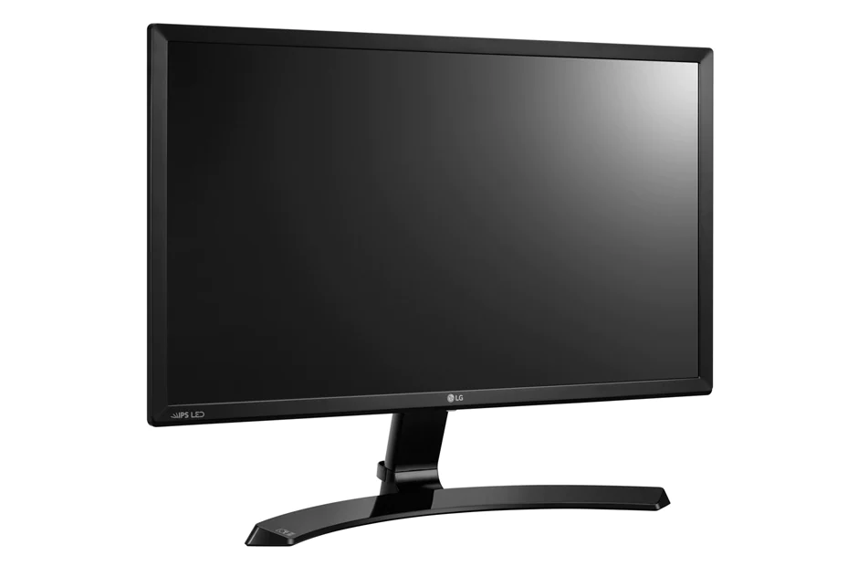

Slide 24
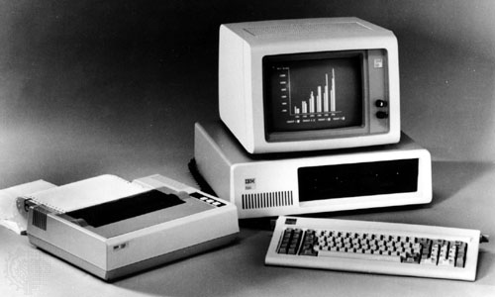

Slide 25
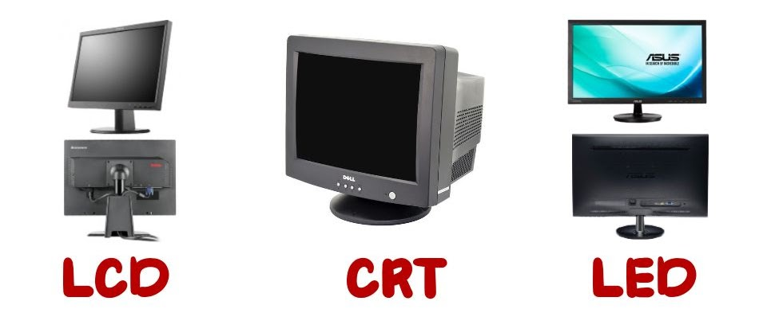
Notes:
Cathode Ray Tube

Slide 26
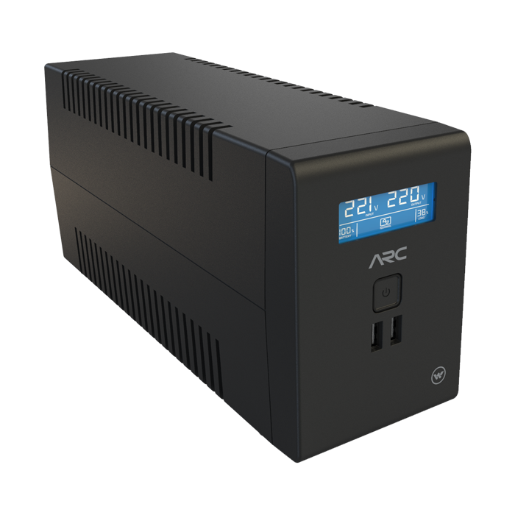
UPS
Uninterruptible (নিরবিচ্ছিন্ন) Power Supply

Slide 27
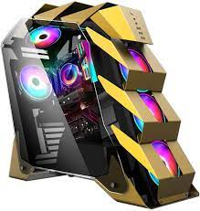
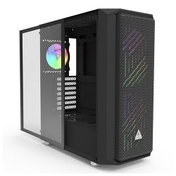
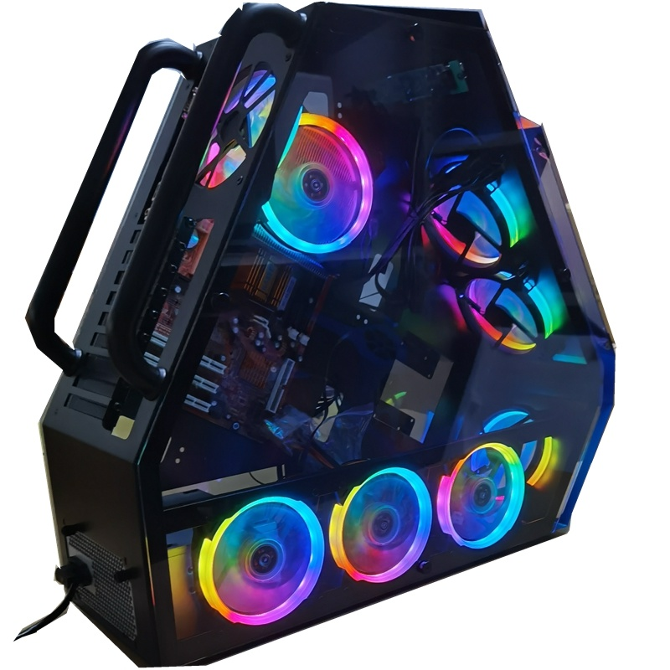
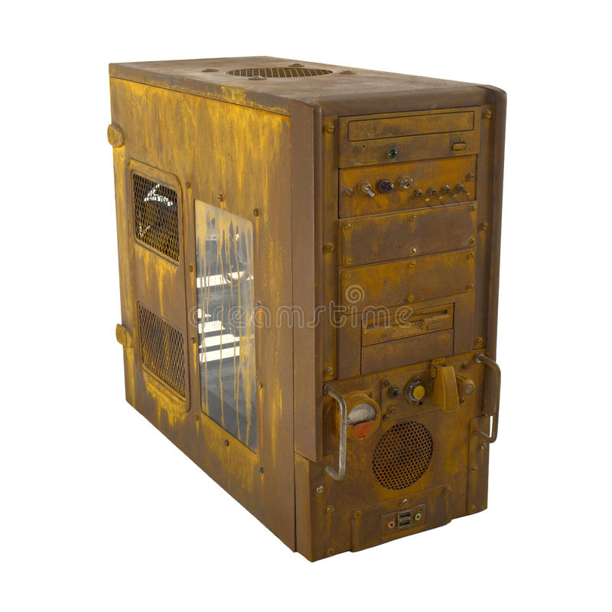
Case (Chassis)

Slide 28
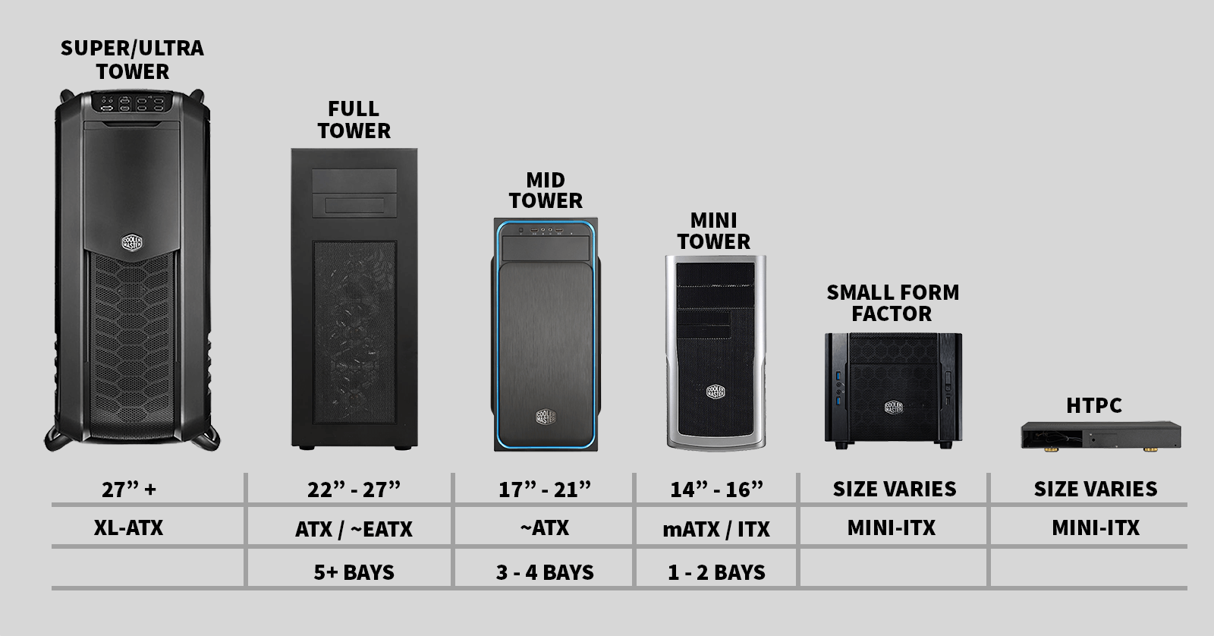
Types of PC Chassis

Slide 29
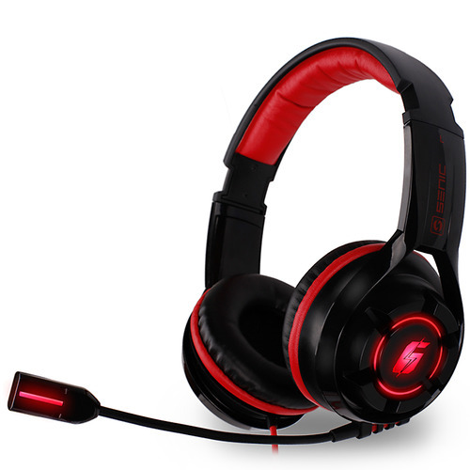
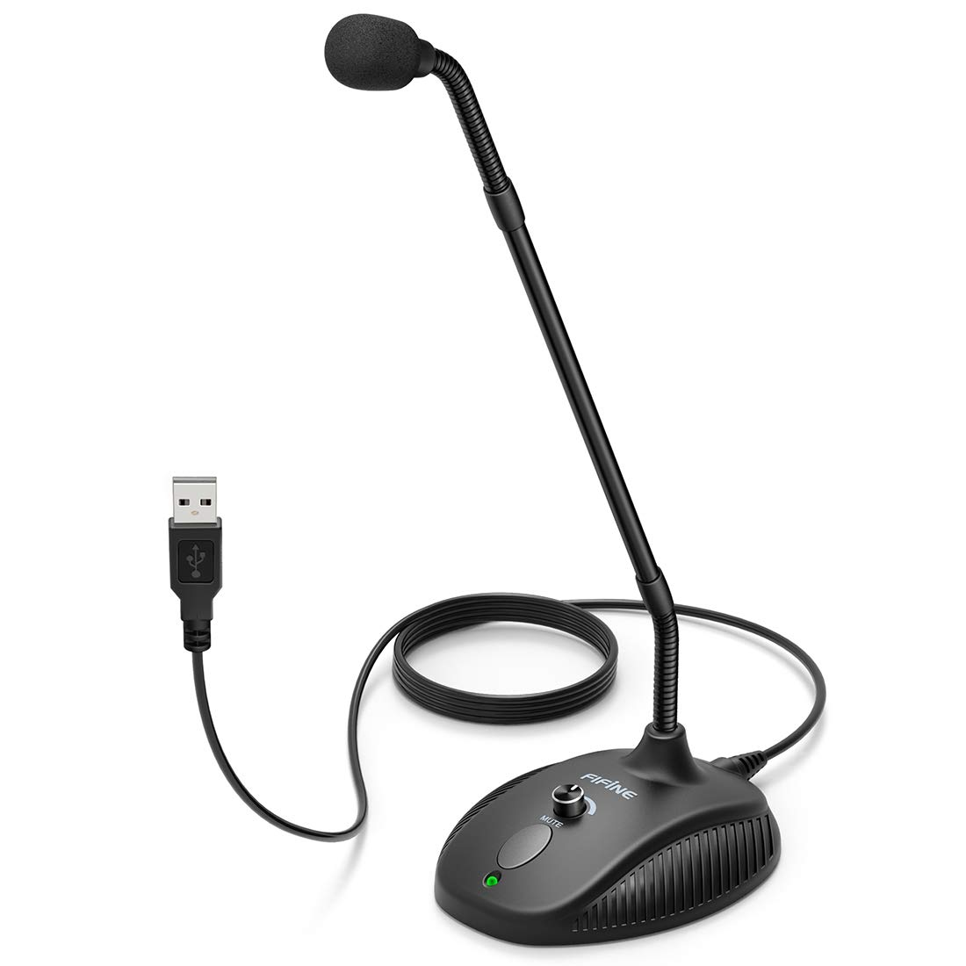
Microphone

Slide 30
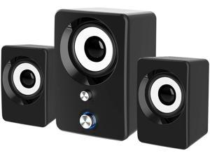
Speaker

Slide 31
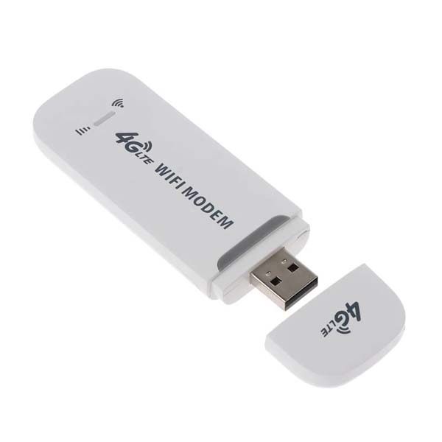
Modem
Modulator Demodulator

Slide 32
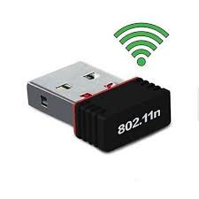
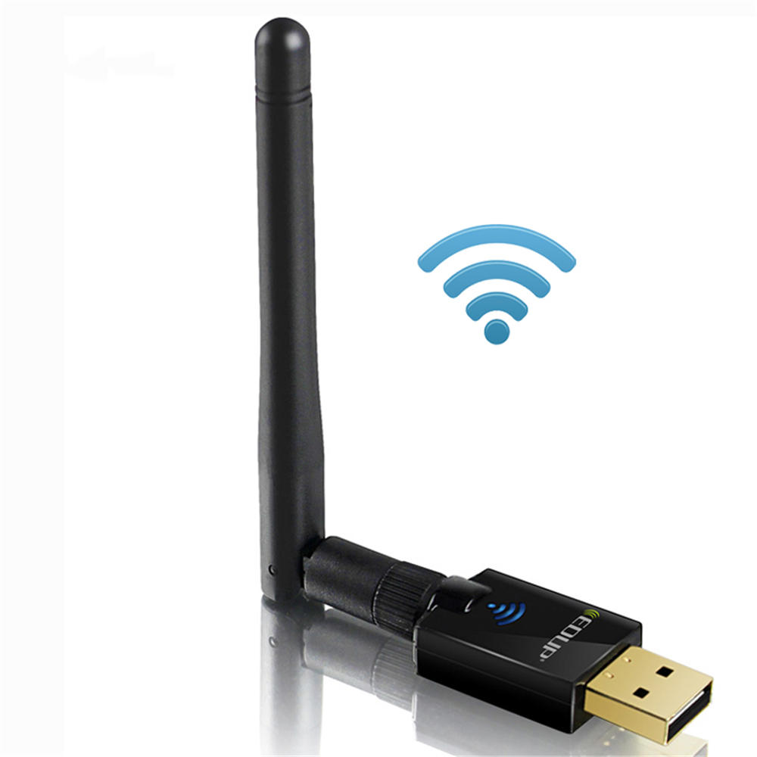
Wifi Receiver

Slide 33
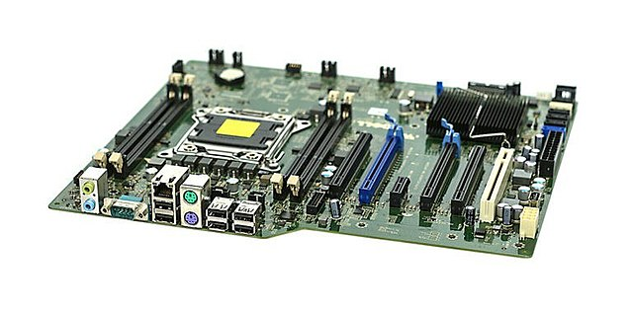
Motherboard
Other Names: Main Board, Backplane Board, Base Board, Main Circuit Board, Logic Board
Types: Standard ATX, Micro ATX, Extended ATX
Top Companies: ASUS, Intel, Gigabyte, MSI etc

Slide 34
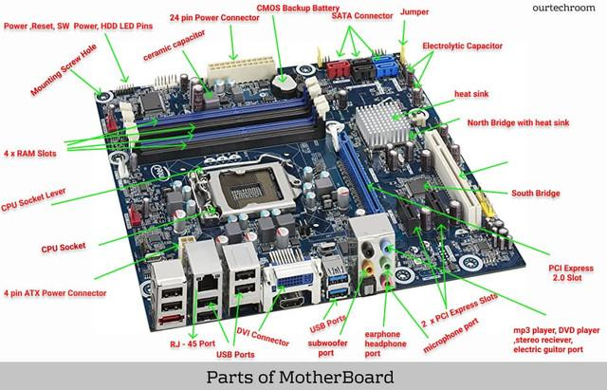

Slide 35
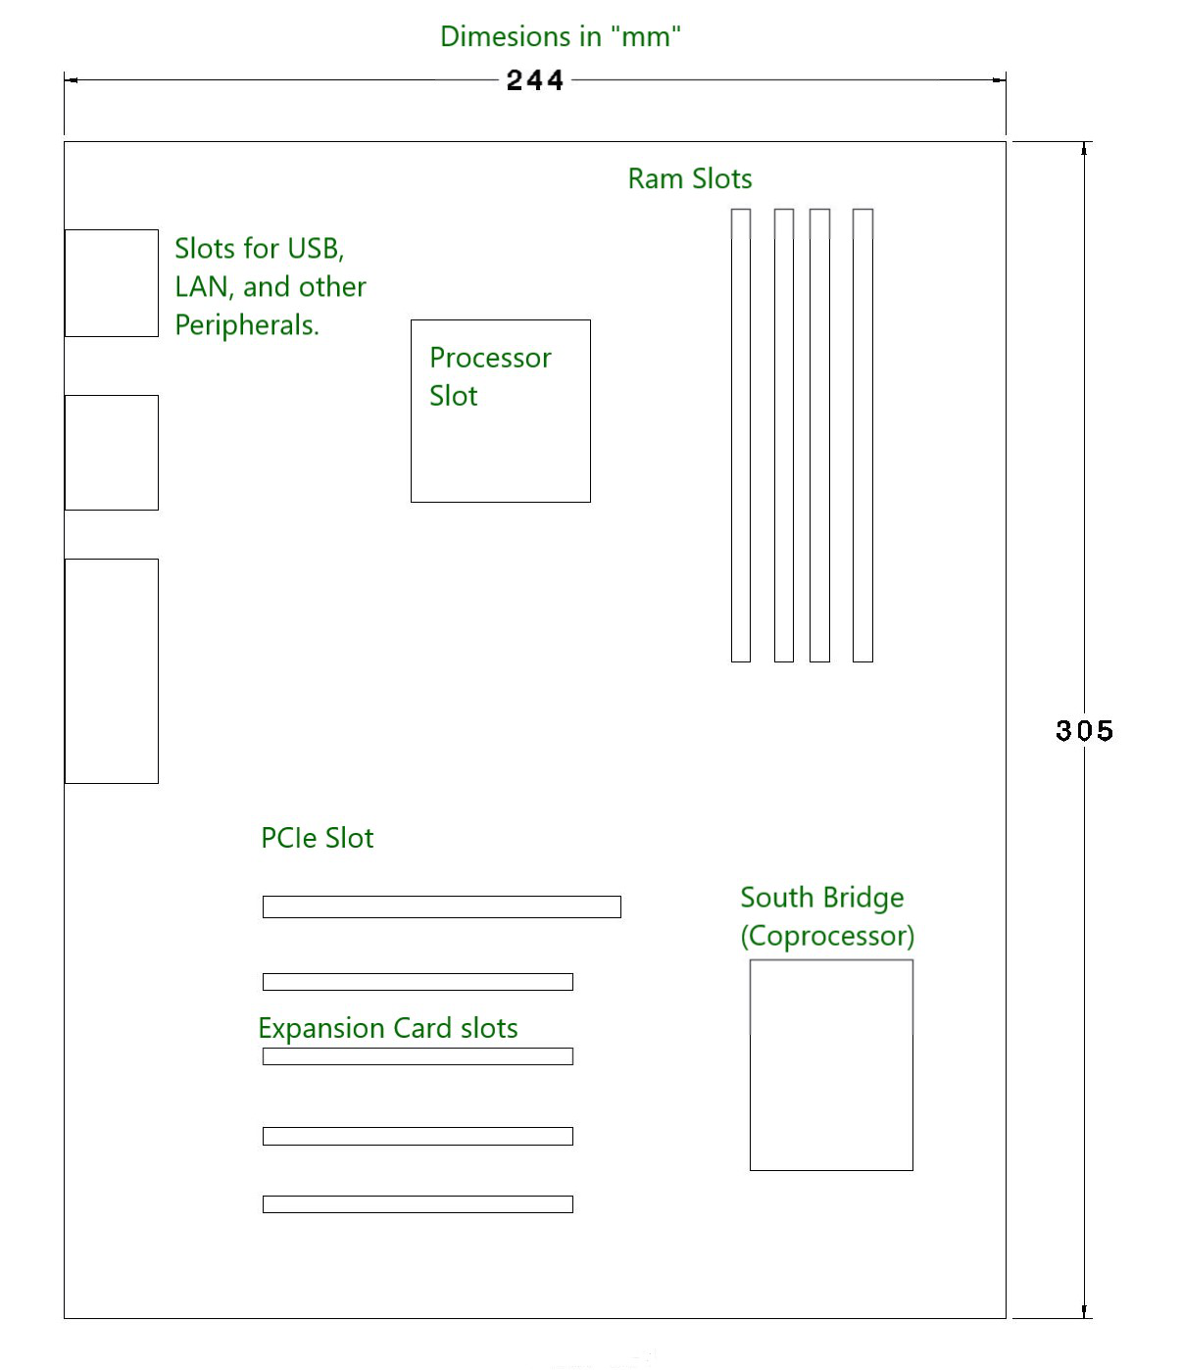
Motherboard (Standard ATX)

Slide 36
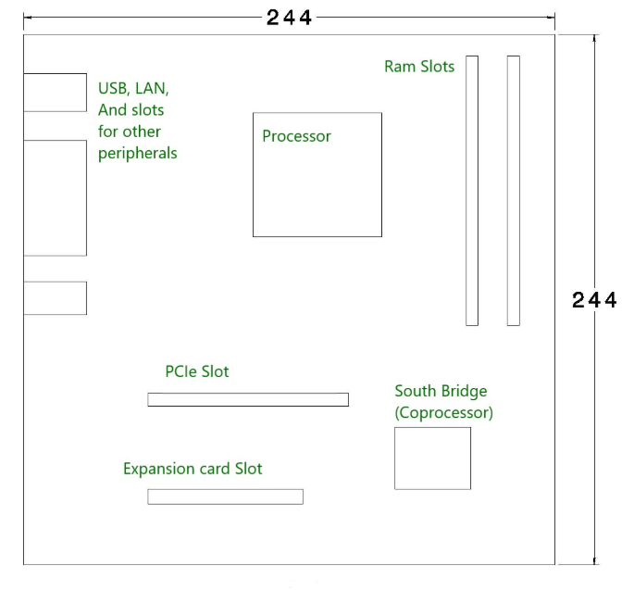
Motherboard (Micro ATX)

Slide 37
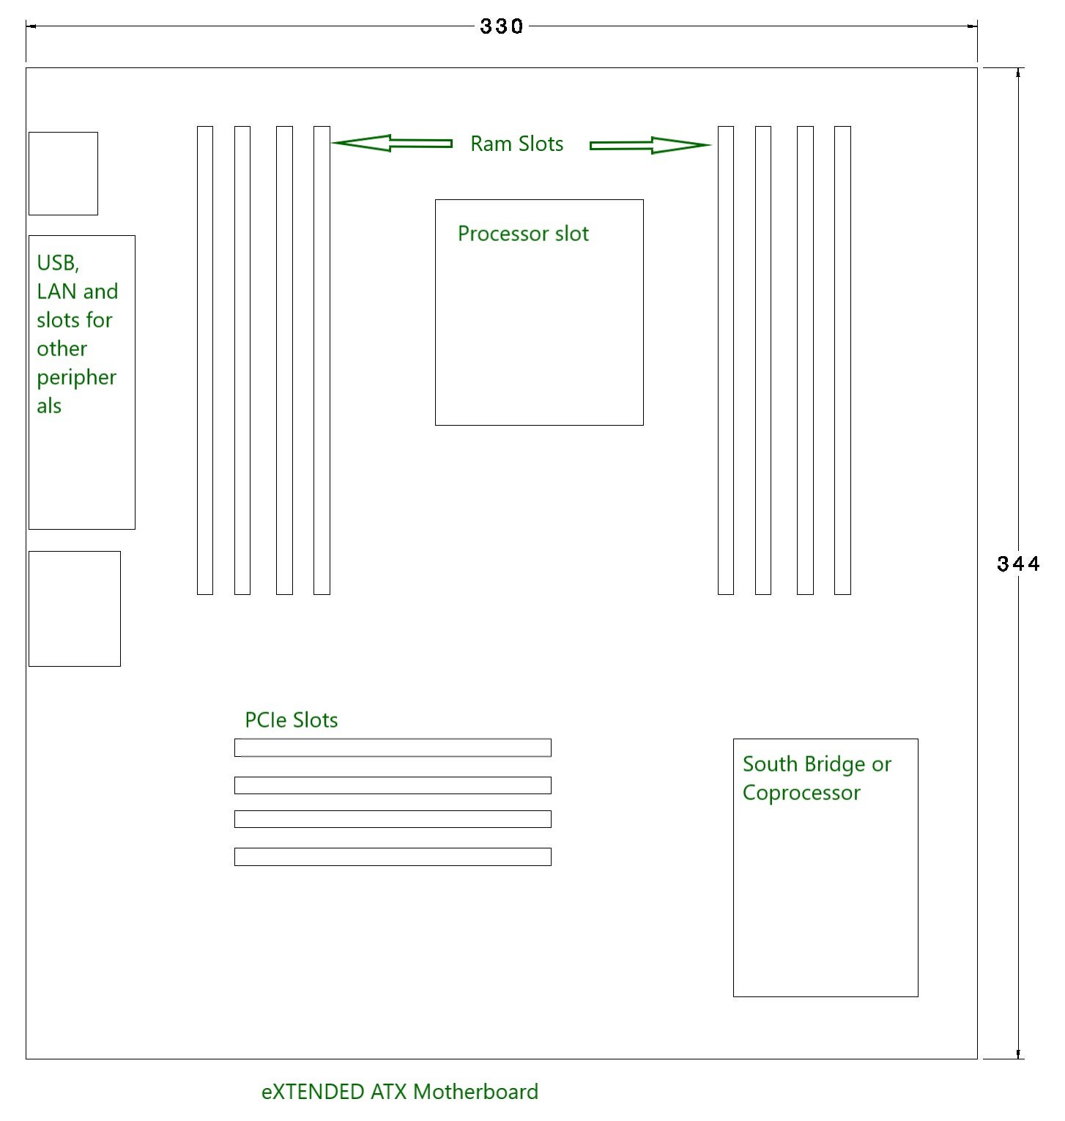
Motherboard (Extended ATX)

Slide 38
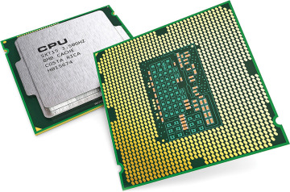
Processor
Heart and Brain of the Computer

Slide 39
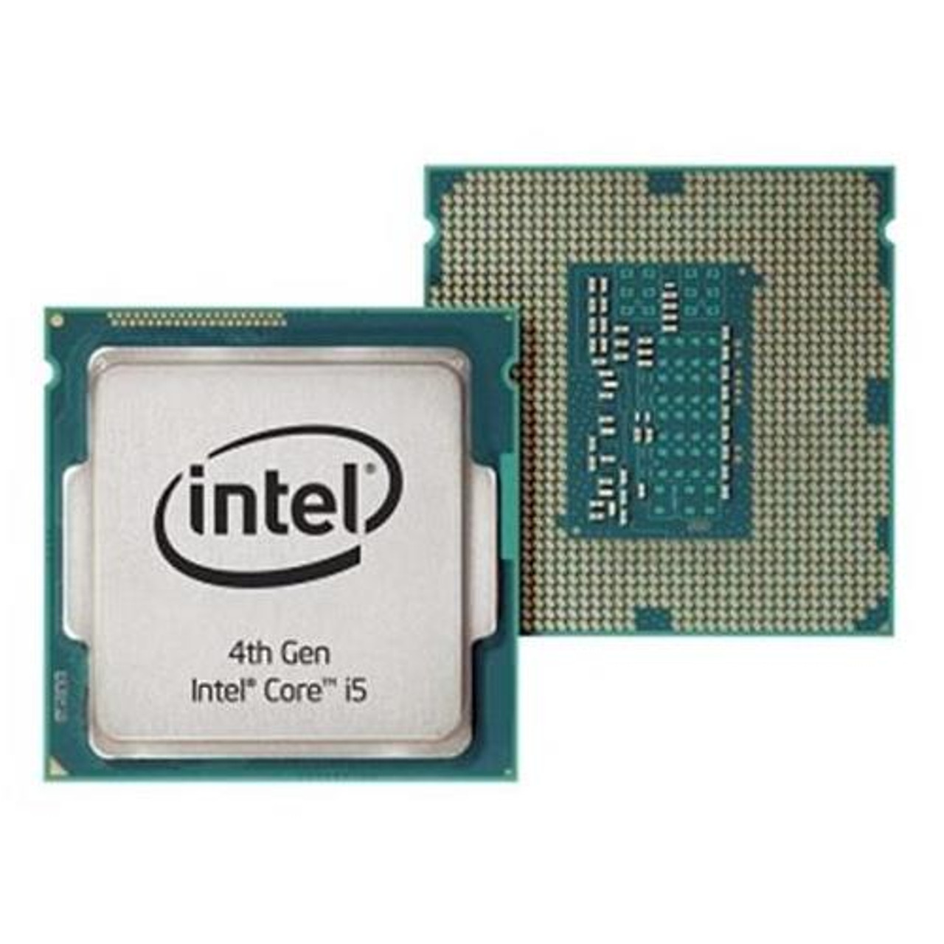
Processor
Basic Elements:
ALU (Arithmetic Logic Unit)
FPU (Floating Point Unit)
Resistor
Memory
Control Unit
Operation:
Fetch, Decode, Execute
Types:
Single Core, Dual Core, Quad Core, Hexa Core, Octa Core, Deca Core
Top Companies:
Intel, AMD Ryzen

Slide 40
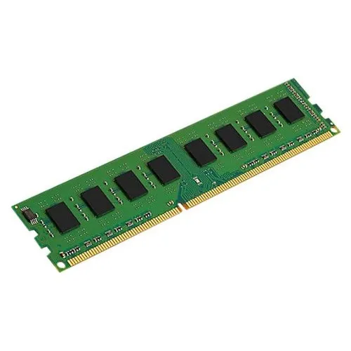
Memory (RAM - Random Access Memory)
Characteristics:
Volatile
Functions:
Reading Files, Temporary Storage, Loading Applications
Types:
Static RAM (SRAM), Dynamic RAM (DRAM)

Slide 41

Memory (ROM - Read Only Memory)
Characteristics:
Non Volatile
Programs are pre recorded by manufacturer.
Once it done, it cannot be changed.
Functions:
To store data permanently
Holds programs or data when computer is powered off
Example of Function:
To store the boot sequence program to start
the computer, OS startup,

Slide 42

RAM vs ROM

Slide 43

Power Supply Unit
Function:
To convert the electrical power (AC) comes from wall socket
to a suitable type and voltage (DC) so that components of a computer
works perfectly.

Slide 44

Hard Drive (HDD)
Characteristics:
Secondary storage device
Non Volatile
Electromechanical data storage device (magnetic disk)
Functions:
Store OS, System Programs and other files

Slide 45

Components of HDD

Slide 46

SSD (Solid State Drive)
Characteristics:
Storage Device
Non volatile
Uses Integrated Circuits Assembly
Types:
SATA SSD
M.2 SATA SSD
mSATA SSD
M.2 PCI-E SSD
M.2 NVMe SSD

Slide 47

Difference between SSD and HDD

Slide 48

CD ROM / DVD ROM
CD: Compact Disc
DVD: Digital Versatile Disc

Slide 49


Video Card
Known as Graphics Card
Function:
Contains the memory and other circuitry necessary to send
Information to the monitor for display on screen.

Slide 50


Sound Card
Known as Audio Card
Attached to the ISA or PCI slot on a motherboard
to enable the computer to input, process, and deliver sound.

Slide 51
Cables of Computer

Slide 52

USB Cable
Universal Serial Bus Cable

Slide 53

HDMI Cable
High Definition Multimedia Interface
Transfer high definition audio and video
Used for:
Projector, Digital TV, DVD Player etc

Slide 54

VGA Cable
VGA: Video Graphics Array
Transfer video signals CPU to Monitor

Slide 55

DVI Cable
DVI: Digital Visual Interface
Uses to display device such as monitor, projector, etc.

Slide 56


SATA Cable
SATA: Serial Advanced Technology Attachment
Function:
To connect a computer's host bus adapter to storage devices
such HDD, SSD

Slide 57


Difference between SATA Power and Molex Power?
Molex is an old technology that powers most of your internal components. Molex power has four pins on the connector and four wires.
Talking about SATA power cables, these are L-shaped cables with 15-pins on the connector. However, we can only see five cables in the SATA wire.

Slide 58


Ethernet Cable
Provide Internet Connection
Connect device to a network

Slide 59

5 mm Audio Cable
Transmit audible signals such as voice and music

Slide 60
Any other components left?
?

Slide 61

Dust

Slide 62
Section-2:
Assembling Desktop PC (Step By Step)

Slide 63


Assemble of a Basic Desktop PC

Slide 64


Slide 65


Slide 66


Slide 67


Slide 68


Slide 69


Slide 70


Slide 71



Slide 72



Slide 73


Slide 74



Slide 75


